Slide 1
Introduction of Linux Driver Development
Neusoft
May 10, 2011
Notes:
04/08/08 02:23 PM

Slide 2
Agenda
Brief Intro of Linux driver?
Char device driver and a simple example.
Memory management in Linux
Miscellaneous
Reference materials for study&research
Notes:
04/08/08 02:23 PM

Slide 3
Brief Intro of Linux driver – I
System Call系统调用是应用程序和操作系统内核之间的接口,设备驱动程序是操作系统内核和CPU等硬件之间的接口.设备驱动程序为操作系统内核屏蔽了硬件的细节,而操作系统的各种内核subsystems/components则为应用程序屏蔽了驱动的实现差异.这样在应用程序看来,硬件设备只是一个设备文件,应用程序可以象操作普通文件一样对硬件设备进行操作.
Notes:
04/08/08 02:23 PM

Slide 4
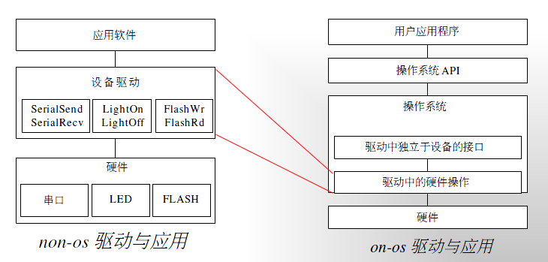
Brief Intro of Linux driver – II
software architecture comparison on OS and non-OS
Notes:
04/08/08 02:23 PM

Slide 5
Brief Intro of Linux driver – III
理论上,某些Linux驱动可以存在于用户空间,而通常情况下device driver设备驱动都是kernel的一部分,主要原因:驱动程序通常需要访问设备的I/O空间,以及申请中断和操作DMA.
设备驱动程序通常需要完成以下功能:
1.对设备进行初始化和释放.
2.把数据从内核传送到硬件和从硬件读取数据.
3.读取应用程序传送给设备文件的数据和回送应用程序请求的数据.
4.检测和处理设备产生的中断和错误.
Notes:
04/08/08 02:23 PM

Slide 6
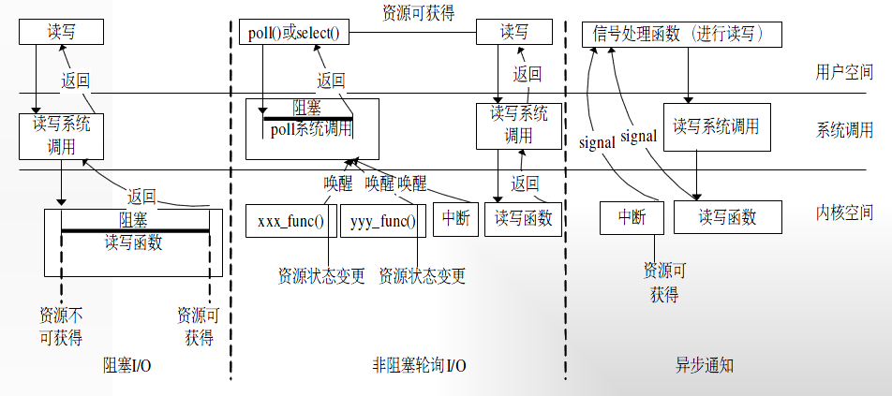
Brief Intro of Linux driver – IV
Notes:
04/08/08 02:23 PM

Slide 7
Brief Intro of Linux driver – V
Linux device driver types：
  Char device driver --
  Block device driver
  Net device driver
  Frame buffer
  USB Host/Device
  SD/MMC/SDIO
  PCI/PCI-E, I2C, SPI ...
Notes:
04/08/08 02:23 PM

Slide 8
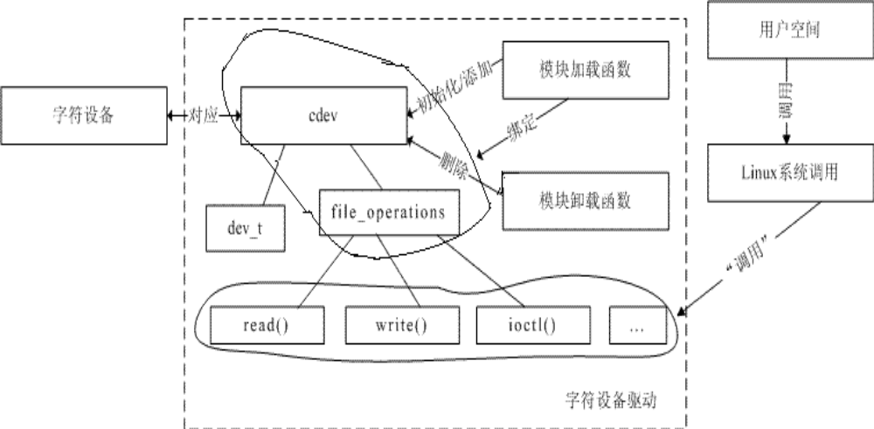
Char device driver
Notes:
04/08/08 02:23 PM

Slide 9
Operatons of char device in <linux/kernel.h>
struct file_operations {
struct module *owner;
ssize_t (*read) (struct file *, char *, size_t, loff_t *);
ssize_t (*write) (struct file *, const char *, size_t, loff_t *);
int (*ioctl) (struct inode *, struct file *, unsigned int, unsigned long);
int (*open) (struct inode *, struct file *);
int (*release) (struct inode *, struct file *);
};
Notes:
04/08/08 02:23 PM

Slide 10
A simple sample of char device -- I
struct file_operations test_fops =
{
read: test_read,
write: test_write,
open: test_open,
release: test_release,
ioctl: test_ioctl,
};
Notes:
04/08/08 02:23 PM

Slide 11
A simple sample of char device -- II
/* open the device. */
static int test_open(struct inode *inodePtr, struct file *fp)
{
printk( "Enter open routine.\n" );
return 0;
}
/* close the device. */
static int test_release(struct inode *inodePtr, struct file *fp)
{
printk( "Enter test_release\n" );
return 0;
}
Notes:
04/08/08 02:23 PM

Slide 12
A simple sample of char device -- III
/* read from the device. */
static ssize_t test_read(struct file *fp, char *buf, size_t len, loff_t *offset)
{
printk( "Enter test_read\n" );
return len;
}
/* write to the device. */
static ssize_t test_write(struct file *fp, char *buf, size_t len, loff_t *offset)
{
printk( "Enter test_write\n" );
return len;
}
Notes:
04/08/08 02:23 PM

Slide 13
A simple sample of char device -- IV
/* handle the pre-defined commands. */
static int test_ioctl(struct inode *inodePtr, struct file *fp, unsigned int cmd, unsigned long arg)
{
switch( cmd )
{
default:
break;
}
return 0;
}
Notes:
04/08/08 02:23 PM

Slide 14
A simple sample of char device
-- How to register/unregister a char device
int test_init_module(void)
{
register_chrdev( 100, testName, &test_fops );
printk( "Init test module\n" );
return 0;
}
void test_cleanup_module(void)
{
unregister_chrdev( 100, testName );
printk( "UnInit test\n" );
}
module_init ( test_init_module );
module_exit ( test_cleanup_module );
Entry point
Exit point
Notes:
04/08/08 02:23 PM

Slide 15
A simple sample of char device
-- How to compile and make a device node
Compile and make drv.ko
  gcc -D__KERNEL__ -DMODULE -I/usr/src/linux-2.x.y/include -c -O -Wall drv.c -o drv.o
Insmod & rmmod
Make device node
  mknod /dev/test c 100 0
Check node ： ls /dev/test -l
Notes:
04/08/08 02:23 PM

Slide 16
A simple sample of char device
-- How to access the device in user space
int main(int argc, char *argv[])
{
int fd;
char buf[256] = "Hello World!!";
fd = open( "/dev/test”, O_RDWR ); // → test_open 被调用
if ( fd == -1 )
{
printf( "Open drv driver fail.[Application]\n“ );
return -1;
}
write( fd, buf, 6 ); // → test_write 被调用
close( fd ); // → test_close 被调用
return 0;
}
Notes:
04/08/08 02:23 PM

Slide 17
Memory management in Linux -- I
Memory management interfaces in Linux:
kmalloc(), get_free_pages(), vmalloc(), malloc()
What about the differences among them?
How can we transact data between user/kernel space?
Can we share memory between user/kernel space, and how to do?
When should we use mmap( ) or __copy_to/from_user( )?
How to get a block of contiguous physical memory with huge-size?
Notes:
04/08/08 02:23 PM

Slide 18

Memory management in Linux – II
Some materials maybe helpful to you:
Notes:
04/08/08 02:23 PM

Slide 19
Miscellaneous – synchronization -- I
Resource protection and synchronization
  semaphore, mutex
  wait_queue_head_t,
  completion -- encapsulation of wait_queue_head_t
  Local_disable_irq, local_enable_irq
  Schedule, msleep, msleep_interruptible,
  wake_up
Notes:
04/08/08 02:23 PM

Slide 20
Miscellaneous – synchronization – II
  spin_lock: SMP, UP,
  spin_lock, spin_unlock.
  spin_lock_irqsave, spin_unlock_irqrestore.
  -- with RT patch(Suspended or NOT).
  rw lock -- improve the performance of reading operatinons.
Notes:
04/08/08 02:23 PM

Slide 21
Miscellaneous – synchronization – II
  They are shared resources themselves.
  1. How to protect themselves???
  mb – memory barrier
  rmb/wmb
2. when and how should we use them?
notes: atomic operation and memory barrier.
Notes:
04/08/08 02:23 PM

Slide 22
Miscellaneous – Interrupt handling -- I
Top half (th): common entry → dispatch → specific handler
For ARM : IRQ hardware entry → arch/arm/kernel/entry-armv.S
usr_entry() or svc_entry()
get_irqnr_and_base() --- include/asm-arm/arch-xxx/entry-macro.S
do something for preemption //ifdef CONFIG_PREEMPT
irq_handler -- arch/arm/kernel/entry-armv.S
{ asm_do_irq() --- arch/arm/kernel/irq.c
{ irq_desc *desc = irq_desc + irq_nr; //find the descriptor.
irq_enter();
desc->handle_irq() //call its registered handler
irq_exit();
//…
}
}
do something for preemption //ifdef CONFIG_PREEMPT
Notes:
04/08/08 02:23 PM

Slide 23
Miscellaneous – Interrupt handling – II
Initialize IRQ when starting kernel:
start_kernel() -- init/main.c
{ //…
setup_arch(); -- arch/arm/kernel/setup.c //For ARM
{
get mdesc // get machine descriptor
init_arch_irq = mdesc->init_irq; //function pointer
-- for mxc: == mxc_init_irq() --- arch/arm/kernel/irq.c
//…
}
// …
init_IRQ() { init_arch_irq(); //… }
//…
}
Notes:
04/08/08 02:23 PM

Slide 24
Miscellaneous – Interrupt handling – III
On-chip or external Interrupt controller.
on-chip: AVIC, TZIC, NVIC
external: 82559, some pmic chips, bridge-chips,
or EPIC based on FPGA.
EPIC – external programmable interrupt controller.
register irq_chips for them with common dispatching handler, or route it to specific handler directly. Please refer to arch/arm/plat-xxx/irq.c for some details.
Data structure:
irq_chip
irq_desc
irqaction -- can be a linklist. Shared interrupt
Notes:
04/08/08 02:23 PM

Slide 25
Miscellaneous – Interrupt handling – IV
Bottom half (bh)
workqueue: default(keventd), create(own kthread)
softirq: ksoftirqd
types: HI, TIMER, NET_TX/RX,TASKLET
tasklet: ksoftirqd
Notes:
04/08/08 02:23 PM

Slide 26
Miscellaneous – Interrupt handling – V
-- Questions
Top half (th)
how to request/free a specific irq handler?
Bottom half (bh)
The functions about workqueue?
The functions about tasklet?
To describe their mechanism and implementation.
Notes:
04/08/08 02:23 PM

Slide 27
Miscellaneous – others
Soft timers -- timer_list
mach_desc – the definition of some a board.
start_kernel –
timer.c --- clock_source and clock_event
Notes:
04/08/08 02:23 PM

Slide 28
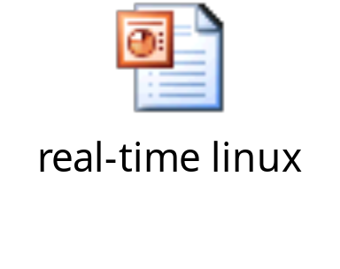
Miscellaneous – Preemption and Real-time
RTLinux ---- FSMLabs – WindRiver --- Intel
dual-kernel: RTCore and linux kernel.
RT patch for common kernels.
HR-Timer – high resolution.
some materials:
Notes:
04/08/08 02:23 PM

Slide 29
Reference materials for study&research
Linux Document Project
  http://www.tldp.org
Advacend linux programming
  http://www.advancedlinuxprogramming.com/alp-folder
Linux device drivers
  http://www.xml.com/ldd/chapter/book/
LINUX 核心程序设计
  Linux kernel programming M Beck
Understanding the LINUX KERNEL
  Bovet & Cesati
Linux server hacks
Notes:
04/08/08 02:23 PM

Slide 30
Contact
yu.ht@neusoft.com
Notes:
04/08/08 02:23 PM

